Slide 1
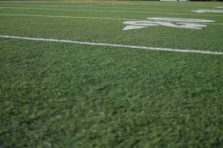
NFL Players
Environmental factors (civic, natural, cultural) that create a the makings of a professional football player.
P1G5kin Research
Justus Jarvis
David Aradom
Alex Miller

Slide 2
Hypothesis
If you come from a state with a NFL franchise then you are more likely to reach the NFL than states without them.

Slide 3
States
1.CA
2.FL
3.TX
4.GA
5.OH
46.NH
47.ME
48.RI
49.AK
50.VT
What is it about these states that produce more professional football players than other states?
Probable Factors explored:
  League Demographics/State Demographics
  Civic Conditions (economy, criminality, education)
  Geographical Conditions (conducive to practice/play)
  Culture/Tradition -(Hx of FB and current opportunities)
P1G5kin Research

Slide 4
Active Players
We decided to use data with active players in mind. Information would be easier to access from the past 50 years.
This is based on the fact that oldest current active player is Adam Vinatieri (b. 1972).
There are over 1600 active roster players in the NFL
P1G5kin Research

Slide 5
Player and State Demographics

Slide 6
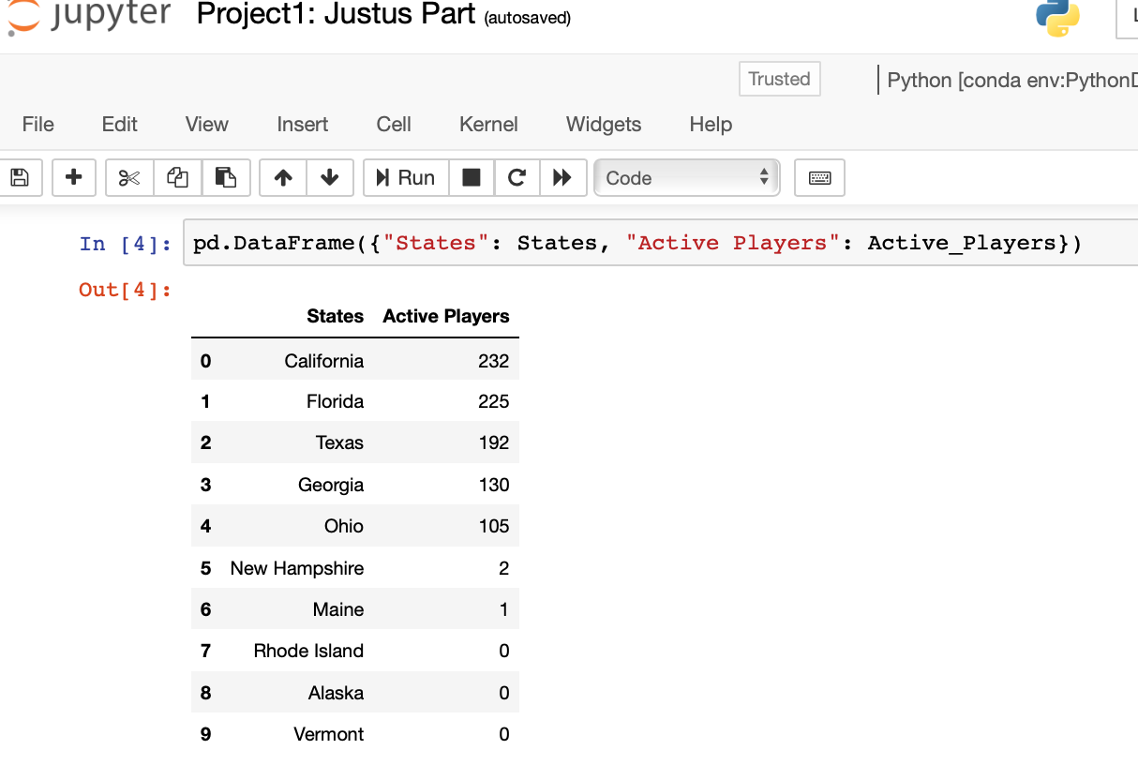
Player Distribution
Created a Data Frame for active NFL players based on the top states that produce and bottom states to produce.
The top 5 states make up about 50% of the league roster
INFO OR GRAPHIC
P1G5kin Research

Slide 7
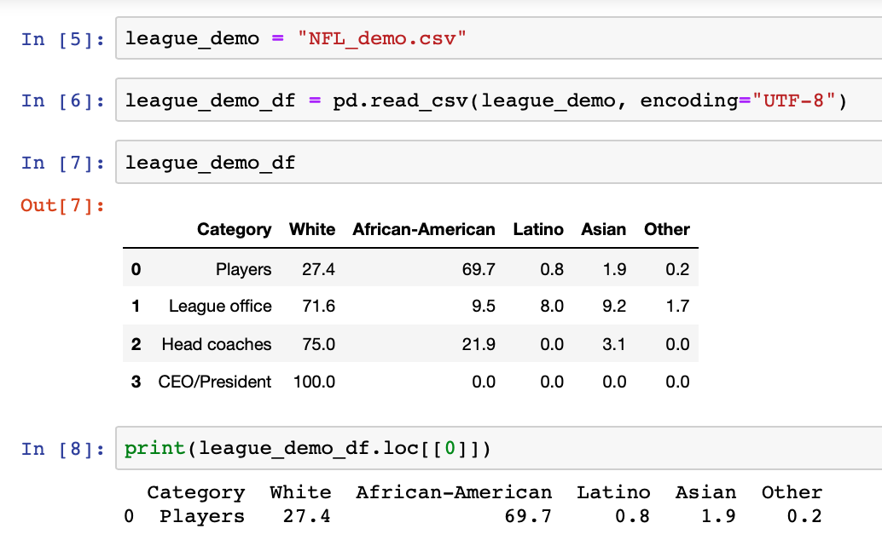
Creating the Data Frame
Utilizing the current NFL demographics locate the player info, and focus data frame on those percentages.
P1G5kin Research

Slide 8
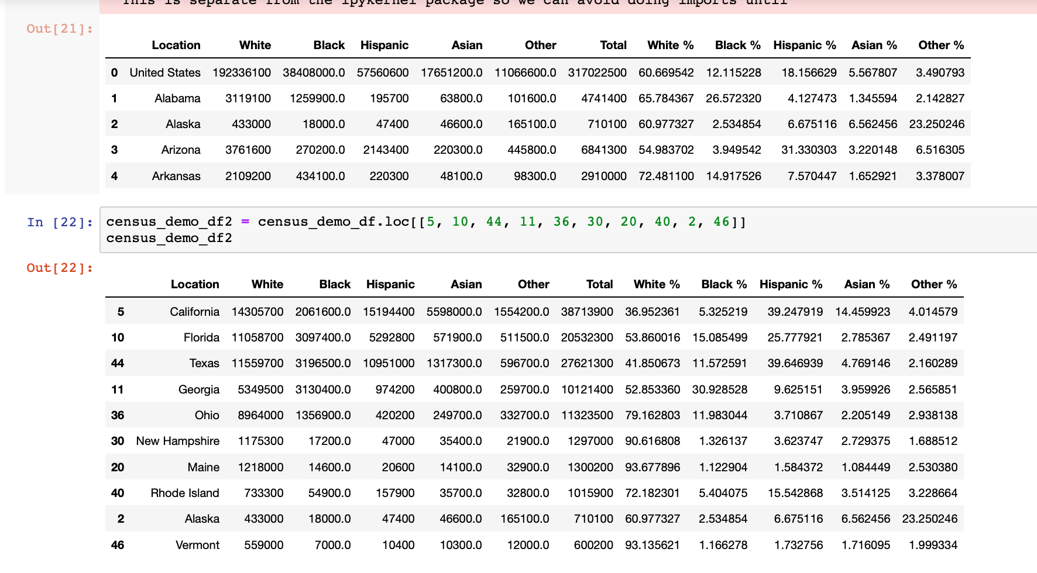
Creating the Data Frame
After completing some data clean, a new data frame was created to track the demographics by state.
P1G5kin Research

Slide 9
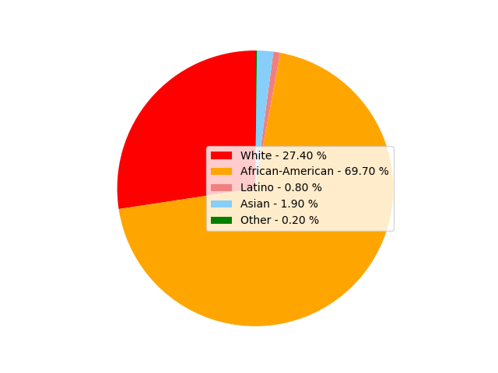
League Demographics
This ethnic breakdown will be used to compare the demographics of the NFL currently to the states in which are producing the most & least professional football players.
P1G5kin Research

Slide 10
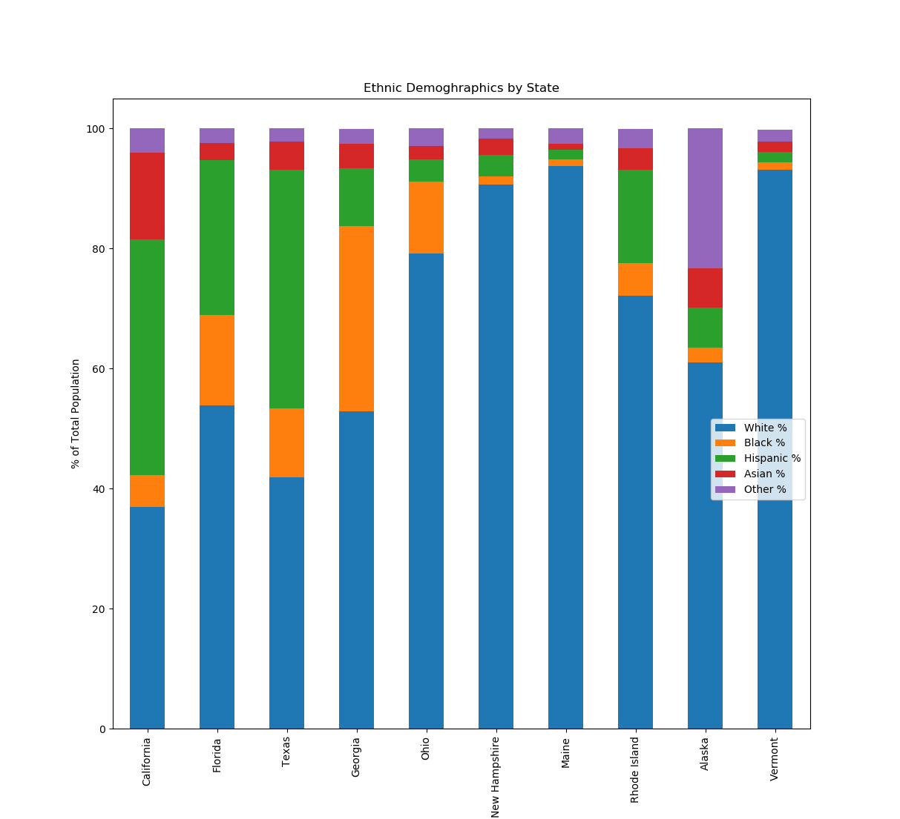
P1G5kin Research

Slide 11
Civic Data

Slide 12
How does crime, college education, and personal income factor in the rate of pro players produced in these top 5 and bottom 5 states?
Expectation: I expect less crime, a bachelor’s degree or higher, and higher income would correlate to more pro football athletes
P1G5kin Research

Slide 13
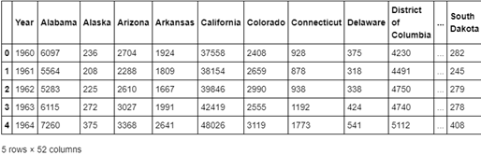
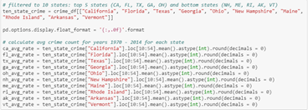
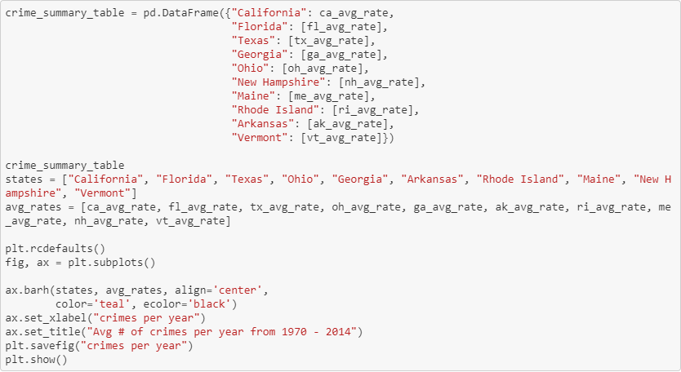
Crime
Captured the total number of crimes for all states from 1960 - 2014
Used Jupyter Notebook to filter out 10 states and years 1970-2014 and calculate the annual avg crime count per state
P1G5kin Research

Slide 14
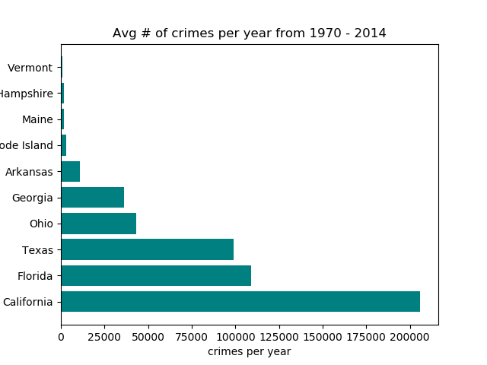
Crime
All top 5 states (CA, FL, TX, OH, GA) all have the highest avg crime count
Population of these states may have skewed the data
Doesn't support my expectation that less crime leads to more pro football athletes
P1G5kin Research

Slide 15
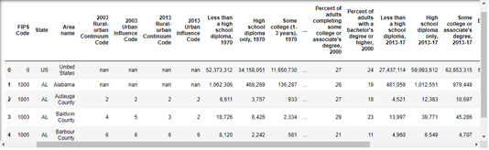
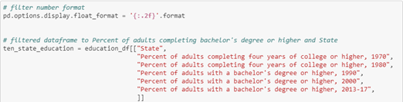
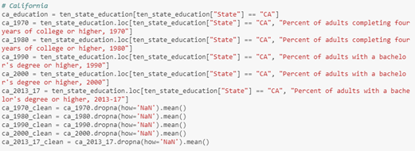
Education
Captured the adults 25 or older with college education attainment per state from 1970-2017 for a 10-yr avg
Used Jupyter Notebook to filter out 10 states and columns for college data only
Calculated the avg of adults completing bachelor’s or higher and removed 'NAN' values
P1G5kin Research

Slide 16
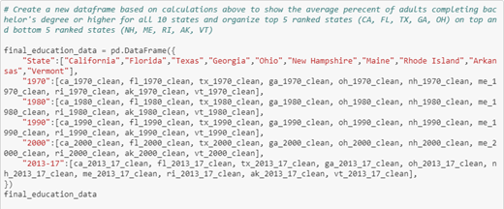
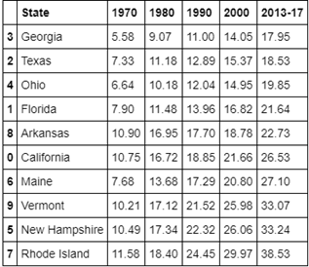
Education
Created a new DataFrame based on calculations in the previous slide to show the avg of adults completing a bachelor’s degree or higher for all 10 states
P1G5kin Research

Slide 17
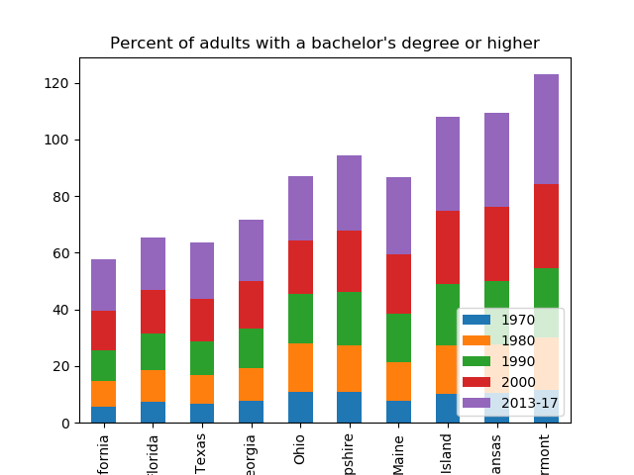
Education
All top 5 states (CA, FL, TX, OH, GA) had lower college attainment and doesn’t support my expectation of higher education leading to more pro athletes
Next step I would analyze is comparing the youth athletic sport programs in top top 5 states vs. bottom 5
P1G5kin Research

Slide 18
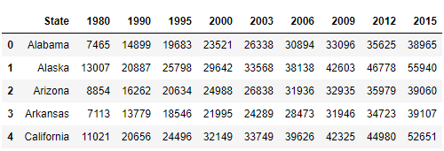
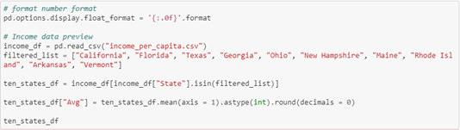
Personal Income
Captured the average personal income by state for 1980-2015
Used Jupyter Notebook to filter out 10 states and created a new dataframe with an added column to calculate the avg
P1G5kin Research

Slide 19
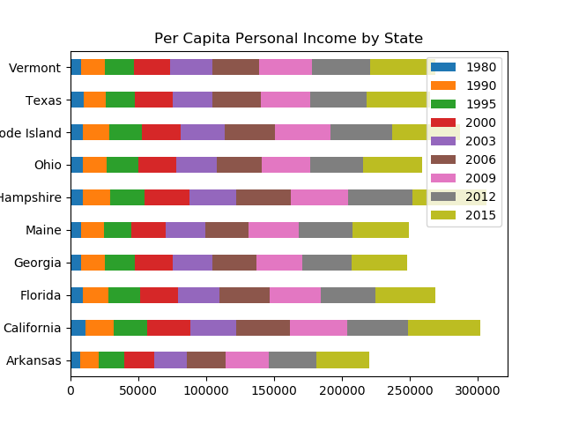
Personal Income
Originally attempted to add a bar and line graph but failed to tell a story
Next I graphed the avg personal income for a state by state comparison but the visualization did not provide any insight
I eventually concluded I was not able to tell a story with the bar graph, and if I had more time I would look to plotting a Histogram
P1G5kin Research

Slide 20
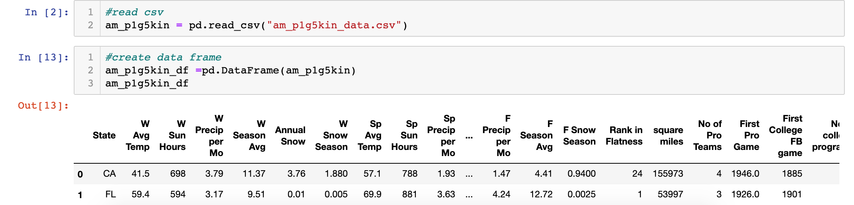
Environmental Factors
Geographical and Cultural

Slide 21
Practice Makes Pros
Traditionally football is practiced and played outdoors.
To practice enough to become a professional football player. You’d need conducive weather and flat space.
P1G5kin Research

Slide 22
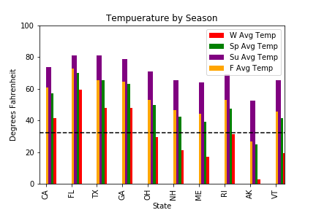
TEMPERATURE
4 of top 5 states do not fall below the freezing line
3 of 4 seasons AK is under the freeze line
Temperature By Season
P1G5kin Research

Slide 23
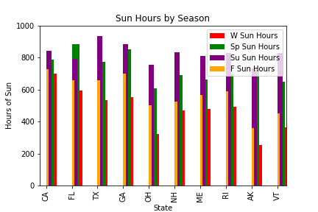
SUN
4 of top 5 state sun hours don’t fall below 500 hours/ season
All have substantial summer light hours, the major differences are in the fall and winter
P1G5kin Research

Slide 24
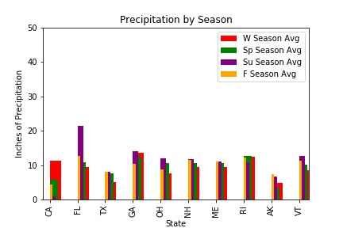
Precipitation
Little Variance with regards to amounts and distribution by season
FL Summer standout could be due to Hurricane season
P1G5kin Research

Slide 25
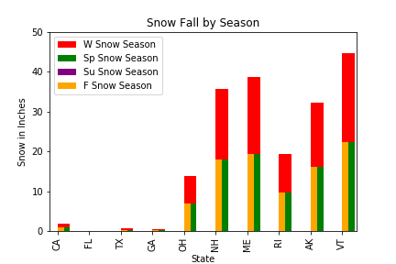
SNOW
Given Annual snowfall
Seasonal calculated by quartile formula
VT avgs approx 80” of snow /year
P1G5kin Research

Slide 26
Lay of the Land
Topographical Factors
P1G5kin Research

Slide 27
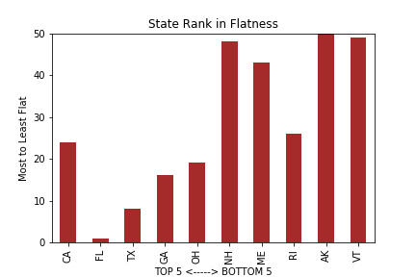
Flatness
2017 study
Top 5 player producers fall within 50 flattest
4 of the 5 bottom states are ranked 43,48,49, & 50.
P1G5kin Research

Slide 28
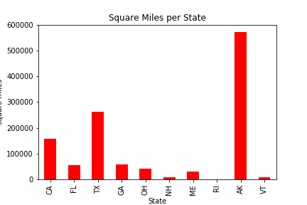
Area
While AK has most space it is the least flattest state in the country
Poor little RI
1212 square miles
TX: A lot of Flat Space
P1G5kin Research

Slide 29
Professional Football Hx
1892: 1st Paid Player
1893: 1 Contract
1896: 1st Full Pro Team for short season
1897: 1st Entire Pro Team for Full Season
1899: Formation of longest running professional team
  Morgan Athletic Club in Chicago: Normals, Racine Cardinals,
Chicago Cardinals, St. Louis Cardinals, Phoenix Cardinals,
Arizona Cardinals.
1902: 1st attempt at Professional League
1920: American Professional Football Conference
1922: Changed to National Football League (NFL)
P1G5kin Research

Slide 30
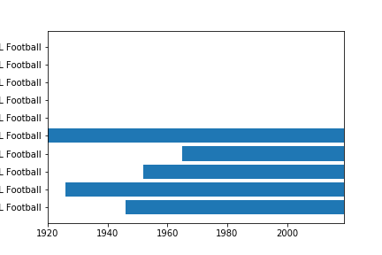
Hx
Of the Original 18 Teams Ohio had 7 teams
  Dayton
  Columbus
  Canton
  Cleveland
  Akron
  Toledo
  Oorang
Of top five GA most recent Falcons in 1965
NFL PRESENCE IN STATES FROM 1920 TO 2019
VT
NH
ME
AK
RI
OH
GA
TX
FL
CA
P1G5kin Research

Slide 31
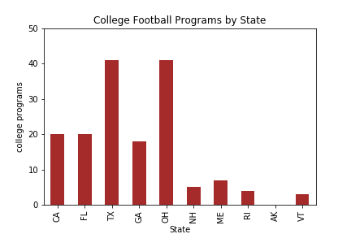
CFB
TX & OH tops with 41 schools
Bottom 5 all under 10
AK
P1G5kin Research

Slide 32
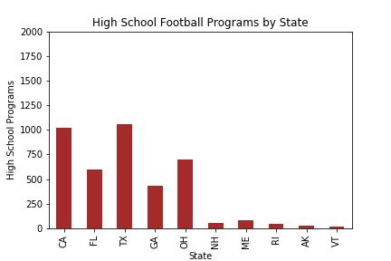
TOPIC
Again a major difference in opportunities by state
Points of interest
Points of interest
P1G5kin Research

Slide 33
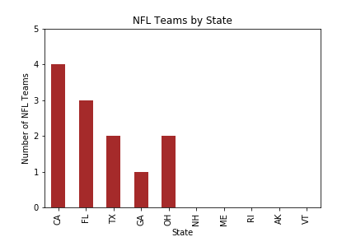
TOPIC
Points of interest
Points of interest
Points of interest
P1G5kin Research

Slide 34
Nature & Nurture:
A Brief Summary
4 of the top five states have noticeably better weather conditions compared to the bottom 5 states
  Warmer weather year round
  More Sun Hours year round
  Less /No snow
Top 5 states considerably flatter and have more area* (Mountainous AK)
Top 5 have more opportunities at HS & College Level
Top 5 50+ years of an NFL presence
Top 4 of the top 5 have multiple NFL Teams in the State
P1G5kin Research

Slide 35
Resources
https://www.pro-football-reference.com
https://www.currentresults.com/Weather/US/average-state-weather.php
http://www.disruptivegeo.com/2015/08/the-flatness-of-u-s-states/
https://statesymbolsusa.org/symbol-official-item/national-us/uncategorized/states-
size
https://www.profootballhof.com/football-history/chronology-of-professional-foot
ball/
https://en.wikipedia.org/wiki/List_of_the_first_college_football_games_in_each_
US_state
http://prwolfe.bol.ucla.edu/cfootball/LinksList.html
https://www.nfhs.org/ParticipationStatistics/PDF/2016-17_Participation_Survey_
P1G5kin Research

Slide 36
THE END(zone)
P1G5kin Research

